Slide 1

CSE1222
The Ohio State University

Slide 2
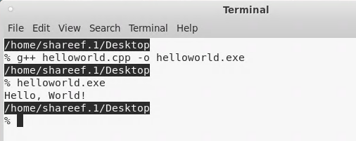

External Data Sources
C++ Program
cin
cout
So far, this is how our programs in this class have worked.
CSE1222:
The Ohio State University

Slide 3
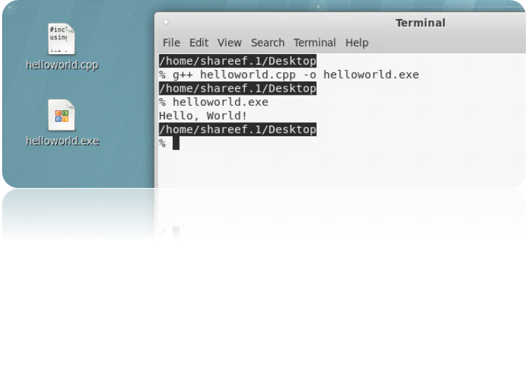
helloworld.cpp
#include <iostream>
using namespace std;
int main()
{
cout << "Hello, World!" << endl;
return 0;
}
> helloworld.exe
Hello, World!
>
Output comes to display screen
CSE1222
The Ohio State University

Slide 4
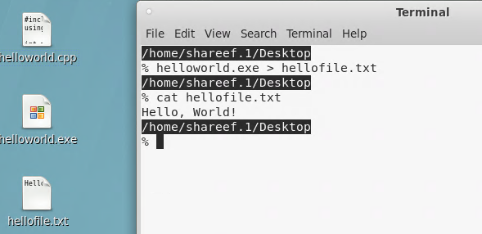
Unix: Redirecting Output to a File
On the Unix (Linux) command line, the symbol ‘>’ redirects output to a file
> helloworld.exe > hellofile.txt
> cat hellofile.txt
Hello, World!
In Unix, the cat command
displays the contents of a file.
CSE1222
The Ohio State University

Slide 5
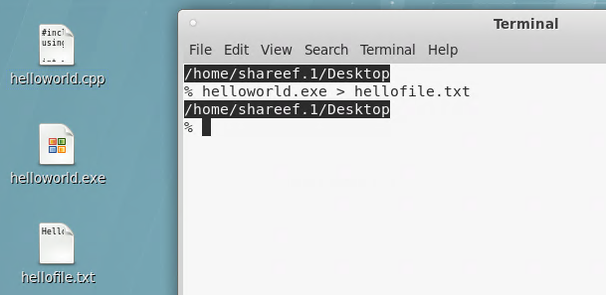
External Data Sources
C++ Program
cout
cin
>
Same executable program,
but output goes to different places
CSE1222
The Ohio State University

Slide 6

External Data Sources
C++ Program
cin
cout
ofstream
Can we write code to send output to a file?
Yes!
CSE1222
The Ohio State University

Slide 7

CSE1222
The Ohio State University

Slide 8

File I/O Streams
A File Stream is a one-way data transmission path used to connect a file stored on a physical device (disk, CD-ROM, etc) to a program
  Both input and output file streams
An Output File Stream directs data from a program to a file in linear order
CSE1222
The Ohio State University

Slide 9
File Output: Write to a File
Steps
  Use #include <fstream>
  Create an output stream object
  Establish connection to a file
  Check Validity
  Start writing
  Close the file
CSE1222
The Ohio State University

Slide 10
Writing to Files (1)
Use #include <fstream>
  Defines the class ofstream
#include <fstream> // class ofstream is in fstream
#include <iostream>
CSE1222
The Ohio State University

Slide 11
Writing to Files (2)
“Create an output stream object”
  Create a variable of type ofstream
  ofstream fout;
  Variable fout
    Represents our connection to the file
    Called an output file handler
CSE1222
The Ohio State University

Slide 12
Writing to Files (3)
“Establish a connection to a file”
  Open the file "hellofile.txt"
fout.open("hellofile.txt", ios::out);
Output to the file
CSE1222
The Ohio State University
Notes:
By default with ios::out, the file contents will be deleted if the file already exist

Slide 13
Writing to Files (4)
“Check Validity”
  Dangers when opening a file:
    We may not have permission to write to the file
    Your computer filesystem may have problems
    Etc…
    These are runtime errors that must be handled!!!
  if (!fout.is_open()) // check if file is open
  {
  cerr << "Unable to open file hellofile.txt." << endl;
  exit(10);
  }
CSE1222
The Ohio State University

Slide 14
Writing to Files (4)
“Check Validity” (continued…)
  The exit() function call performs routine maintenance before termination
    Properly closes the file stream
    Terminates the program
    Better than return 0; in this case
  Remember, to use exit() we must first
  #include <cstdlib>
CSE1222
The Ohio State University

Slide 15
Writing to Files (5)
“Start writing”
  At this point the output file handler, fout, is valid and so we can start writing to the file
  This should look familiar...
  fout << "Hello World" << endl;
  Prints "Hello World" to hellofile.txt
CSE1222
The Ohio State University

Slide 16
Formatted Writing to Files
You can do everything with an output file handler (e.g., fout) that you can do with cout
  Note that fout sounds similar to cout, but it is just a variable name I chose
  You can use any valid variable name
This includes IO manipulation
  setprecision(), setw(), etc.
CSE1222
The Ohio State University

Slide 17
Writing to Files (6)
“Close the file”
  When you are finished writing to the file, you must close it :
  fout.close();
  Why?
    To properly empty output buffers
    So our program can reuse fout handler for other file writes
  If our program keeps many files open…
    May mix up output
    Other errors
CSE1222
The Ohio State University

Slide 18
writeFile1.cpp
#include <cstdlib> // function exit() is in cstdlib
#include <fstream> // Step 1. Define class ofstream
#include <iostream>
using namespace std;
int main()
{
ofstream fout; // Step 2. Create output stream object
// Step 3. Establish a connection to the file
fout.open("hellofile.txt", ios::out);
if (!fout.is_open()) // Step 4. Check validity
{
cerr << "Unable to open file hellofile.txt." << endl;
exit(10);
}
CSE1222
The Ohio State University

Slide 19
writeFile1.cpp (continued …)
cout << "Writing to file hellofile.txt." << endl;
// Step 5. Start writing
fout << "Hello World!" << endl;
fout << "Goodbye World!" << endl;
// Step 6. Close output stream
fout.close();
return 0;
}
CSE1222
The Ohio State University

Slide 20
writeFile2.cpp – Formatted Output
#include <cstdlib> // function exit() is in cstdlib
#include <fstream> // define class ofstream
#include <iomanip> // add iomanip for formatting
#include <iostream>
using namespace std;
int main()
{
ofstream fout; // declare an output file stream
// open file file_name for output
fout.open("sample.txt" , ios::out);
// check if file is opened for output
if (!fout.is_open()) {
cerr << "Unable to open file sample.txt." << endl;
exit(10);
}
CSE1222
The Ohio State University

Slide 21
writeFile2.cpp (continued …)
cout << "Writing to file sample.txt." << endl;
// write to the file
fout << "Test file output." << endl;
fout << "100.0/3.0 = " << 100.0/3.0 << endl;
fout.precision(12);
fout << "100.0/3.0 = " << 100.0/3.0 << endl;
fout << "100.0/3.0 = " << fixed << 100.0/3.0 << endl;
// close output file stream
fout.close();
return 0;
}
CSE1222
The Ohio State University

Slide 22
File Name
We “hard coded” the file name in our previous example
fout.open("sample.txt" , ios::out);
What if we want the user to tell us the name of the file to write to?
CSE1222
The Ohio State University

Slide 23
File Name May Be:
“hard coded”
fout.open("sample.txt" , ios::out);
char array
char filename[] = “sample.txt”;
fout.open(filename, ios::out);
string variable
  string filename = “sample.txt”;
  // or cin >> filename
  fout.open(filename.c_str(), ios::out);
CSE1222
The Ohio State University

Slide 24
writeMultiFile.cpp
. . .
ofstream fout1; // declare output file stream 1
ofstream fout2; // declare output file stream 2
fout1.open("book1.txt" , ios::out); // open book1.txt
fout2.open("book2.txt", ios::out); // open book2.txt
if (!fout1.is_open())
{
cerr << "Unable to open file book1.txt." << endl;
exit(10);
}
if (!fout2.is_open())
{
cerr << "Unable to open file book2.txt." << endl;
exit(15);
}
CSE1222
The Ohio State University

Slide 25
writeMultiFile.cpp (cont)
cout << "Writing to files book1.txt and book2.txt."
<< endl;
// write to book1.txt
fout1 << "Assets: $" << 10000 << endl;
fout1 << "Liabilities: $" << 15000 << endl;
// write to book2.txt
fout2 << "Assets: $" << 12000 << endl;
fout2 << "Liabilities: $" << 9000 << endl;
fout1.close(); // close file stream fout1
fout2.close(); // close file stream fout2
return 0;
}
CSE1222
The Ohio State University

